Slide 1
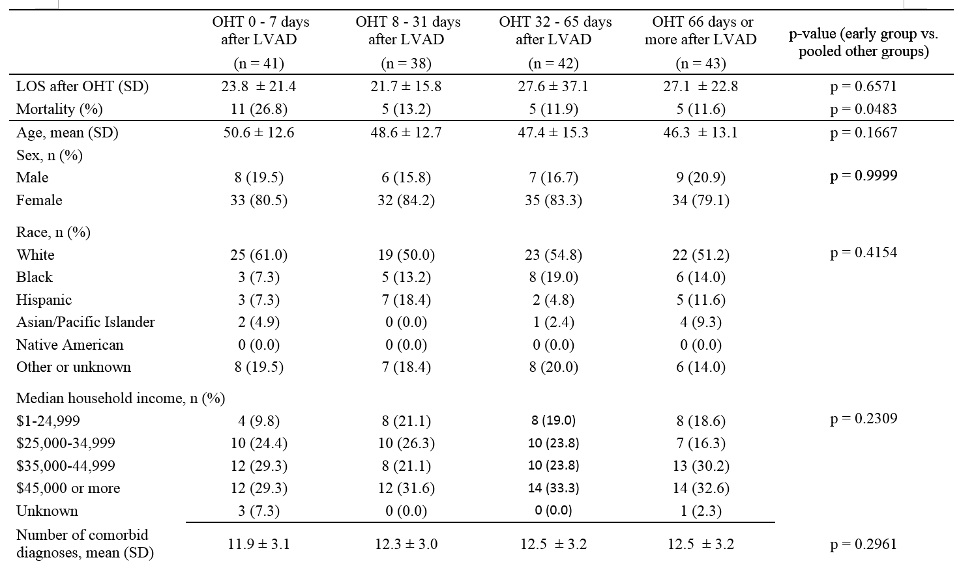
Table 1. Baseline demographics for early and late in-hospital Orthostatic Heart Transplant (OHT) after Left Ventricular Assist Device (LVAD) Implantation

Slide 2
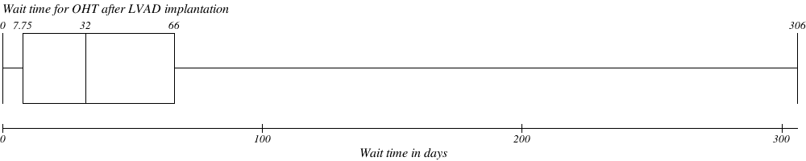

Slide 4
Table 3. Baseline demographics of in-hospital patients who did and did not receive Swan-Ganz Catheterization prior to Left Ventricular Assist Device (LVAD) Implantation
 | Swan-Ganz+ (n = 403) | Swan-Ganz- (n = 1797) | p-value
Age, mean ± SD | 53.4 ± 13.7 | 55.1 ± 13.3
Sex, n (%)
Male | 81 (20.1) | 460 (25.6)
Female | 322 (79.9) | 1337 (74.4)
Race, n (%)
White | 218 (54.1) | 1056 (58.8)
Black | 80 (19.9) | 272 (15.1)
Hispanic | 33 (8.2) | 109 (6.1)
Asian/Pacific Islander | 13 (3.2) | 38 (2.1)
Native American | 0 (0.0) | 5 (0.3)
Other or unknown | 59 (14.6) | 317 (17.6)
Median household income, n (%)
$1-24,999 | 98 (24.3) | 377 (21.0)
$25,000-34,999 | 89 (22.1) | 402 (22.4)
$35,000-44,999 | 90 (22.3) | 462 (25.7)
$45,000 or more | 115 (28.5) | 516 (28.7)
Unknown | 11 (2.7) | 40 (2.2)
Comorbidities
Cardiac Dysrhythmias | 274 (68.0) | 1098 (61.1)
Respiratory failure | 103 (25.6) | 460 (25.6)
Diabetes | 65 (16.1) | 328 (18.3)
Hyperlipidemia | 63 (15.6) | 247 (13.7)
Hypertension | 44 (10.9) | 254(14.1)
History of smoking | 33 (8.2) | 111 (6.2)
BMI ≥ 30 kg/m² | 17 (4.2) | 79 (4.4)
Number of concomitant diagnosis, mean ± SD | 13.6 ± 2.5 | 12.5 ± 3.0
Year of hospitalization, n (%)
1998 | 1 (0.2) | 17 (0.9)
1999 | 10 (2.5) | 31 (1.7)
2000 | 9 (2.2) | 62 (3.5)
2001 | 14 (3.5) | 94 (5.2)
2002 | 4 (1.0) | 89 (5.0)
2003 | 13 (3.2) | 86 (4.8)
2004 | 8 (2.0) | 72 (4.0)
2005 | 14 (3.5) | 65 (3.6)
2006 | 26 (6.5) | 105 (5.8)
2007 | 19 (4.7) | 100 (5.6)
2008 | 42 (10.4) | 167 (9.3)
2009 | 55 (13.6) | 198 (11.0)
2010 | 72 (17.9) | 355 (19.8)
2011 | 116 (28.8) | 356 (19.8)
Location of hospital, n (%)
Rural | 0 (0.0) | 17 (0.9)
Urban | 402 (99.8) | 1779 (99.0)
Unknown | 1 (0.2) | 1 (0.1)
Bedsize of hospital, n (%)
Small | 1 (0.2) | 37 (2.1)
Medium | 49 (12.2) | 180 (10.0)
Large | 352 (87.3) | 1579 (87.9)
Unknown | 1 (0.2) | 1 (0.1)
Teaching status of hospital, n (%)
Nonteaching | 33 (8.2) | 132 (7.3)
Teaching | 369 (91.6) | 1664 (92.6)
Unknown | 1 (0.2) | 1 (0.1)

